Slide 1
Azure Data Lake Storage Gen2 How ADLS Gen2 can help you Plan, Design, and Build lasting data lakes for your customers
Dario Salischiker
dasalisc@microsoft.com
Senior Program Manager,
Azure Storage

Slide 2
Agenda
Introduction to Data Lakes
Azure Data Lake Storage Gen2
Hands on Lab
ADLS Gen2 Technical Overview and Value Prop
Performance and Pricing
MDW Patterns
Roadmap / Partner Ecosystem
Notes:
I’m going to talk about the context that a lot of your customers are finding themselves in regarding the explosion of data they have to deal with to drive insights
We will also talk about the key capabilities of Azure Data Lake Storage Gen2 which will would help you being successful in creating Analytics Solutions
Then we will create an ADLS Gen2 account by using Azure Portal, something that you will need for the Hackathon on day 3
Then I would like to go over a high-level Technical Overview and touch on ADLS Gen2 value proposition, something that could help you when discussing with your customers solutions that you may be implementing
As you most probably need to understand the cost of operating your solutions, we will go over the pricing for ADLS Gen2 and I will share some results based on 3 POCs we executed
Finally, we can go over some variations of the DWH pattern Kal mentioned.

Slide 3
The modern data estate
HYBRID
On-premises
Cloud
Operational databases
Operational databases
Data warehouses
Data warehouses
Data lakes
Data lakes
Reason over any data, anywhere
Flexibility of choice
Security and privacy
Notes:
One of the big challenges we see that customers are currently facing is in dealing with data that exists both on prem and in the cloud, data coming from operational DBs, data coming from streaming sources, data coming from social media platforms.
The data that customers are trying to herd exists in multiple locations and part of the challenge that they are facing is on building an architecture that can address that
How do they solve this data challenges? Do they do it all on prem? Do they do it all in the cloud?
What if there is a need to do it across both platforms? Can they develop a data strategy and use a data store that could help them be successful in dealing with the challenges on trying to drive insights with the modern data estate being structured the way that it is?

Slide 4
What’s a data lake?
A data lake is a centralized repository that allows you to store all your structured and unstructured data at any scale. You can store your data as-is, without having to first structure the data, and run different types of analytics.
Notes:
So, part of the way they can help address those challenges in dealing with their data state that exists in multiple planes is by using a data lake. A data lake is a centralized repository that allows you to store all your data, structured and unstructured at any scale.

Slide 5
WHAT MAKES A GREAT DATA LAKE?
Massive scale
Granular, multi-layered Security
Optimized for Maximum Performance
Integration Friendly
Cost Effectiveness
PB Scale, data accessible everywhere, growth on demand
Granular security and protection against accidental data loss
Lightning quick job execution
Supports multiple methods of data ingress, processing, egress and visualization
Cloud economic model with the ability to intelligently manage costs
Rich Data Management and Governance
Notes:
Once this decision towards implementing a data lake is made, what are the characteristics that make a great data lake? This really boils down to 5 or 6 key issues:
The first is scalability. Obviously, if you are building a data lake store that continues to multiply over time, you need a data lake to be massively scalable and able to support PBs of data and with global coverage or multiple locations so you can store the data closer to where you need it.
The second criteria is around Security. When you start talking about doing analytics on multiple locations, you have to be able to provide customers with security that is granular in its scope. Down to file and folder level of security is critical when you are doing this kind of work
The third criteria is performance. When you are doing data analytics you need to make decisions and drive insights quickly. Your data lake should not be a bottleneck in your data pipeline.
Fourth is integration friendly. Very rarely we run into situations where a customer don’t have prior relationships with data management vendors or ISVs. Your data lake storage should support those solutions and integrate with a vast number of partners to reduce implementation effort
Fifth is costs effectiveness. As the solution starts to grow, the cost to expand an on prem solution can be challenging. You need to have a data lake solution that is cost-effective in order to make these initiatives make sense. Cloud economic model bring benefits impossible to match with an on prem solution
Finally, the idea of Data Management and Data Governance: where is the data coming from?, how long it has been in the location?, what is the underlying metadata? For many of our customers it is critical to provide to their constituents the ability to answer these questions.

Slide 6





Azure Data Lake Storage Gen2
A “no-compromises” Data Lake: secure, performant, massively-scalable Data Lake storage that brings the cost and scale profile of object storage together with the performance and analytics feature set of data lake storage
SECURE
MANAGEABLE
FAST
SCALABLE
COST EFFECTIVE
INTEGRATION READY
Support for fine-grained ACLs, protecting data at the file and folder level
Multi-layered protection via at-rest Storage Service encryption and Azure Active Directory integration
Automated Lifecycle Policy Management
Object Level tiering
Atomic file operations means jobs complete faster
No limits on data store size
Global footprint (50 regions)
Object store pricing levels
File system operations minimize transactions required for job completion
Optimized for Spark and Hadoop Analytic Engines
Tightly integrated with Azure end to end analytics solutions
Notes:
So, given the previous challenges, we used them and used them as a guide or blue print for helping us to build ADLS Gen2
What we mean by No-compromise Data Lake is that we took the best of what is available with the cloud object platform, the massive scale that you get with Azure Blob Storage, the economics that you get with running with the cloud object store and we combined it with the compelling feature set that you see in any advanced on prem data lake.
Security: ADLS’ file system support POSIX compliant fine-grain ACLs built on top of the security Azure Object storage provides
Manageability: inherit all features that are available in Azure Blob Storage
Speed: File/folder atomic operations take less to complete than object-level
Scalable: Object Blob Storage availability and scale
Same pricing as Object Blob Storage, lower cost than on-prem, ADLS Gen1 and very competitive with what you see in other cloud solutions
Integration ready as the Azure Blob File System (ABFS) driver is officially part of Apache Hadoop and Spark and is incorporated in many commercial distributions

Slide 7
Lab – ADLS Account Creation

Slide 8
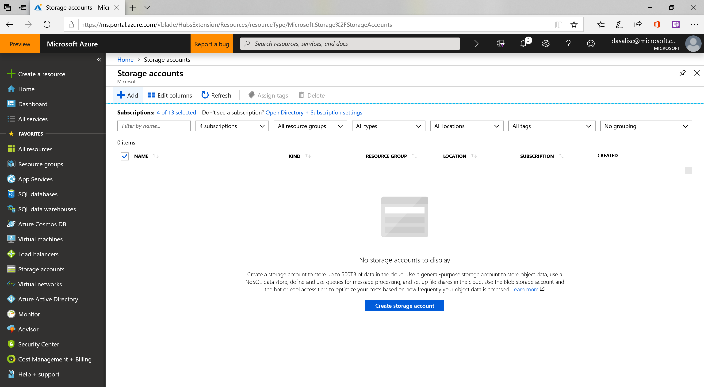

Slide 9
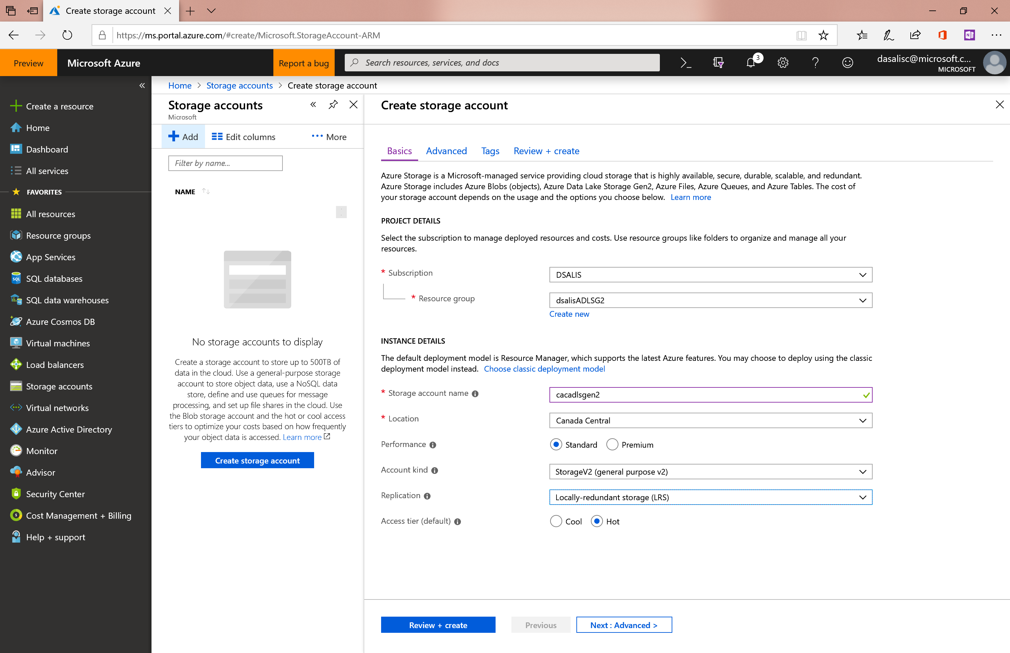

Slide 10
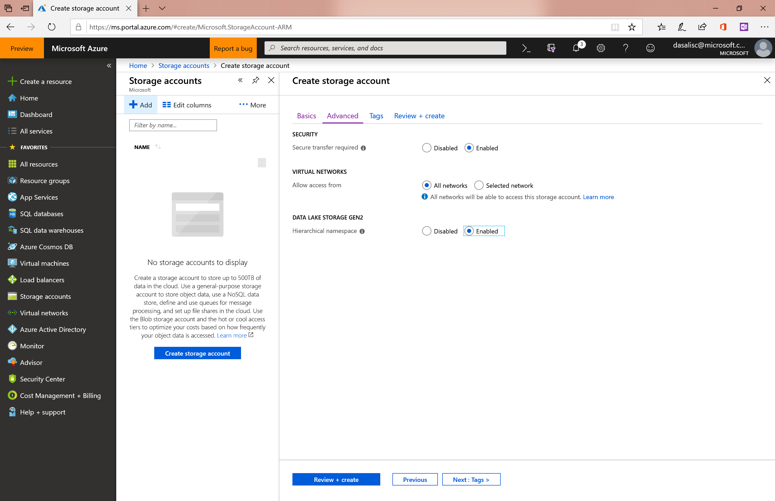

Slide 11
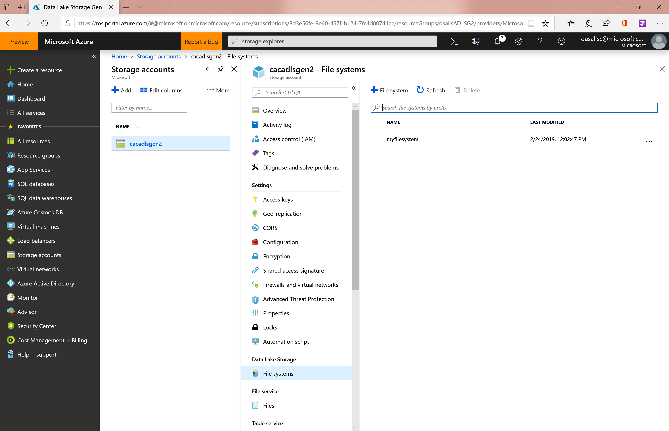

Slide 12

Azure Data Lake Storage Gen2
ADLS Gen2 adds a high performance HDFS Endpoint to Azure Blob Storage and inherits the rich feature set of Azure Blob Storage *
Blob API
Gen2 API
Unstructured Object Data
File Data
Server Backups, Archive Storage, Semi-structured Data
Hadoop File System, File and Folder Hierarchy, Granular ACLS Atomic File Transactions
Common Blob Storage Foundation
Object Tiering and Lifecycle Policy Management
AAD Integration, RBAC, Storage Account Security
HA/DR support through ZRS and RA-GRS
* Full Blob and HNS Interoperability available in post-GA
Notes:
The first point I want to re-emphasize from an architectural perspective is the point that I mentioned when creating the ADLS Gen2 account and is that it has been developed on top of the existing, broadly deployed and proven value of the Azure Object Storage or Blob service.
Why is this important architecturally? The Azure Blob service already has several key capabilities that users are looking for when they build their enterprise data lakes that ADLS Gen2 can transitively benefit from. Things such as object tiering and policy-driven Lifecyle Management are key capabilities when you think about all the data you want to preserve but you don’t want to pay maximum price for it. Storing it at the most optimal tier at a low effort is key here.
Security capabilities and features that we already talked about. The AAD integration with Blob storage again applies to ADLS Gen 2. And other features such as customer managed keys for encryption and vNet integration. And all these features makes storing enterprise data as secure as possible and even more secure that what customers may be doing for instance on on-prem implementations.
The other aspect is the HA/DR stack that we have invest a lot of time to make it right for the Blob storage and this again applies to ADLS Gen2. The possibility to build redundant storage capabilities through GRS and RA-GRS, as well as ZRS capabilities. Doing this on the same stack allows us to benefit from the heavy lifting that Blob storage has already done.
So, understanding that Blob underpins everything is the first step to understanding where the value and benefit of ADLS Gen2 comes from. And then we built on top of that. We have a hierarchical file system that provides file and folder hierarchy. We also have granular ACLs and atomic file transactions driving the performance and cost benefits. Things such as atomic directory renames and manipulation are key to driving analytics performance. Having this capabilities means that it is an atomic operation vs. an unbound operation that is what we have in Blob storage today. Things such as Posix-compliant ACLs again relies on hierarchical name spaces.
And on top of all that we have two APIs. We have the existing Blob API and now we got the new ADLS Gen2 API, which is a file system type API designed specifically for Analytics. The key point is that these two APIs interop across the entire shared data stack which again makes the value pop out even further. It is not just a dedicated file system and then a separate siloed object storage. It is a shared space when I get all these capabilities in an equal fashion.

Slide 13



Azure ADLS Gen2 key audiences & benefits
Data Engineer
Data Scientists
CDO, VP of analytics
Supports familiar REST API and HDFS file system
Integration with leading Hadoop and Spark analytic engines like Databricks
Low Cost Storage for structured and unstructured data
Strong analytics ISV support
Granular file and folder level security
Supports Azure Active Directory Integration and other advanced security features available in Blob Storage
Fast performance leads to lower end to end analytic job run times
Integration with leading Hadoop and Spark analytic engines like Databricks
Supports integration with visualization tools like Power BI and Tableau
Granular file and folder level security
Low Cost Storage for structured and unstructured data
Meets data sovereignty requirements in multiple geographies
Granular file and folder level security
Supports Azure Active Directory Integration and other advanced security features available in Blob Storage
Inherits object level tiering and advanced HA/DR capabilities of Blob Storage

Slide 14

Data Lake Storage Pricing Model
Data Lake Storage Pricing
Azure Blob
Tiers
Hot
Cool
Archive
S3 Standard Storage
Big Query
Frequently accessed data
Less frequently accessed data
Rarely accessed data
PER TB PER MONTH
$18.40
$10.00
$2.00
$23.00
$20.00
Same storage pricing as Azure Blob Storage!*
Supports object level tiering
Competitive with other cloud providers
* Transaction pricing model differences exist; Pricing for LRS availability

Slide 15
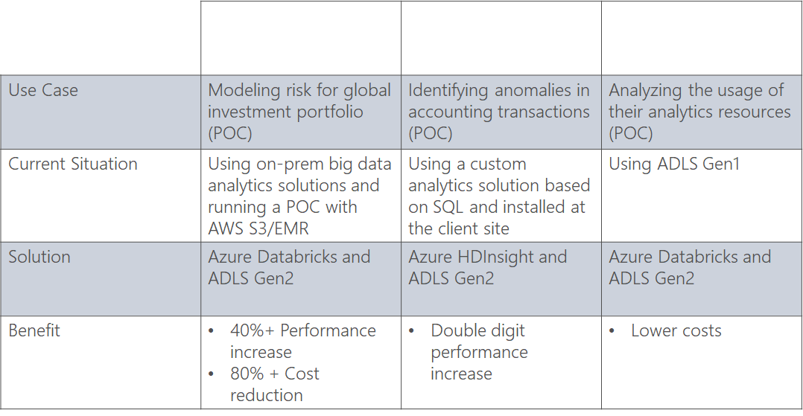
ADLS Gen2 in the real world
POC 1
POC 2
POC 3

Slide 16
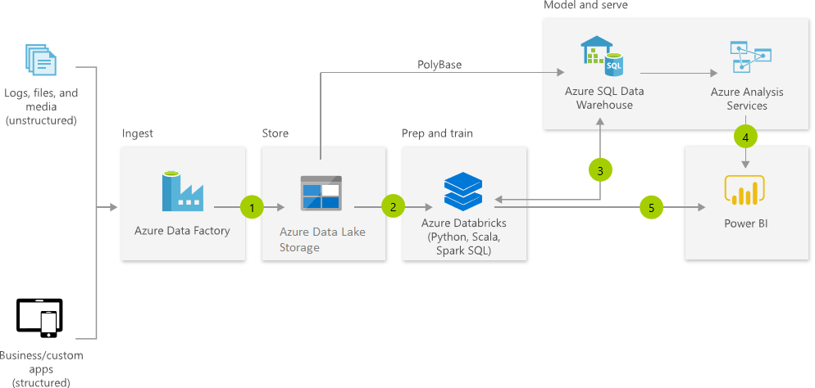

Modern Data Warehouse
Link
Notes:
So now that we have gone through the value propositions, technical architecture, and real-world results of ADLS Gen2, let’s walk through some of the architectural end-to-end patterns that we see customers are using this for.
Modern Data Warehouse is probably one of the most common patterns that we are using, and which resonates well with our customers as it clarifies what they need to use and allows them to align their problems as they see them with a technical solution that we can supply on Azure. The key element of this is that is not prescriptive but is in certain way opinionated in saying OK these are the various components we have specific services that you may need. At the end this simplifies and rationalizes that for customers.
MDW is solving a very well understood pipeline problem that users have been solving on prem for several years. It is about taking different sources of data, both on prem and in the cloud, and both structured and unstructured, dropping them into the Data Lake using something like Azure Data Factory, which is very powerful due to the diversity of sources it can support, both for on-prem and cloud-based sources, bring all that data across, reducing the barrier to ingest the data as much as possible.
Then we have something like Azure Databricks to start conforming the data, improving structure and the scheme and enriching the data by performing scalable analytics to generate cleansed and transformed data. Doing correlation across multiple data sets with that sort of fuzzy logic to bring those data sets together is what is driving the value.
Once we get that data enriched, we get ready to serve it. Again directly from the Data Lake we can use Azure SQL DW or Azure Databrick can also be used for the serving capabilities and then drive that into the more traditional cube and visualization layers that we have in Azure Analytics Services and PowerBI.
So this is a pattern that we see a lot of customers go towards. It drives a lot of value but also helps to clarify to customers what are the sort of services they need to go and interact with.

Slide 17
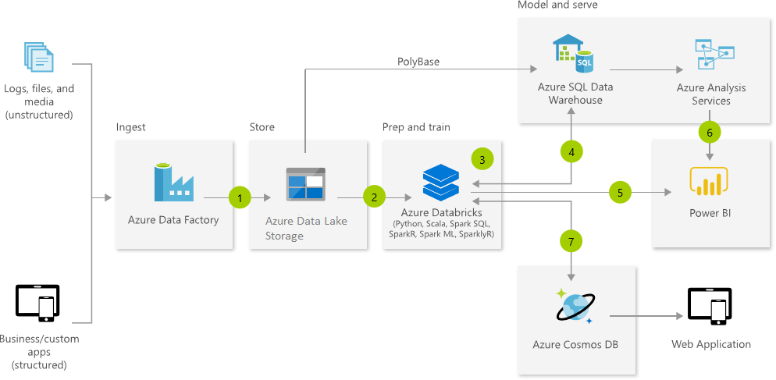
Advanced Analytics
Link
Notes:
Another pattern, that you can see is very similar to the previous one as its front-end of this pattern is largely the same as MDW is the Advanced Analytics one. The front-end may deal with a slightly more diverse set of data as it may deal more heavily with social media sources, but which can also be handled with Azure Data Factory to land the data into ADLS and then enriching it in place with Azure Databricks.
Here users may not just conform and enrich their data, but also leverage it to train ML models using Python or Spark ML and they can leverage Azure Databricks to do that too.
And then it is about serving it. And here is where it may diverge a little bit more from MDW pattern in that we can follow the existing PowerBI visualization pipeline path as well as we did on MDW but then in addition store the data in something like Cosmos DB and then feed that data into an application. This is very common in something like a recommendation engine where the application is driven by the analysis from the data that came before. Again, this is a very common pattern, probably something that is more contemporary with the cloud rather than on prem. But still a very relevant pattern.

Slide 18
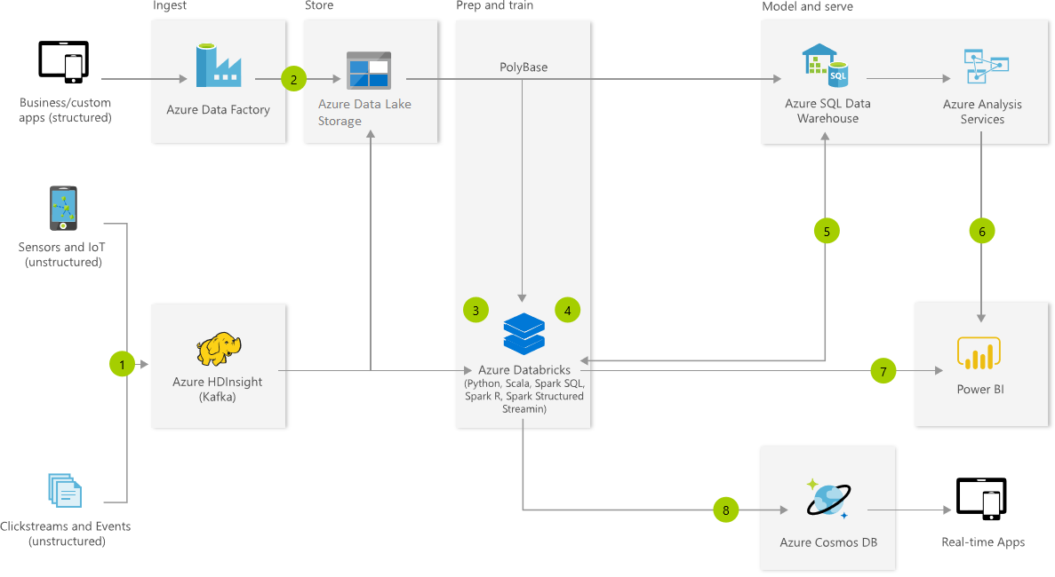
Real-time Analytics
Link
Notes:
The last pattern I want to mention today is dealing with IOT. Part of the explosion of data we are seeing is the very increased prevalence of IOT sensors and flowing that data reads.
One of the characteristics of IOT pipelines is that we have what it is considered the Hot path, where data is being processed almost in real-time to drive things such as alerting or automated responses in for instance automated factory. And then the Cold or cooler path where data is batched up and maybe converged with other data sets to drive the BI or visualization to drive insights.
And we can see here the Hot path where we are bringing the data through a message broker such as Apache Kafka that we support on both HDInsight and Event Hub or even Event Hub capture itself supports this pattern where we got the Hot path driving data into Azure through its micro-batch technology and then through its Cooler path driving the data into ADLS Gen2 and then processing it as we’ve done in the previous patterns as well.

Slide 19
ADLS Gen2 Roadmap
End-to-end experience
OAuth authentication
POSIX-compliant ACLs
Integration with Azure Databricks, HDInsight (incl. Enterprise Security Package), Data Factory, SQL Data Warehouse and Power BI
Integration with many 3rd party tools/services, incl. Attunity, WANDisco, Informatica and Striim
Azure Storage Explorer support
Available in ALL public and sovereign regions
Additional Security Features
Migration support from ADLS Gen1
Post-GA Features
Pass-through end user authentication with Azure Databricks
ADLS Gen2 & Blob Interoperability
Upgrade support for existing Blob content
Complete integration with Azure Data services
Integrated Data Catalog
Native query support
Data Governance
Ungated Public Preview
Dec 2018
General availability
Feb 7th 2019
GA+
GA++

Slide 20
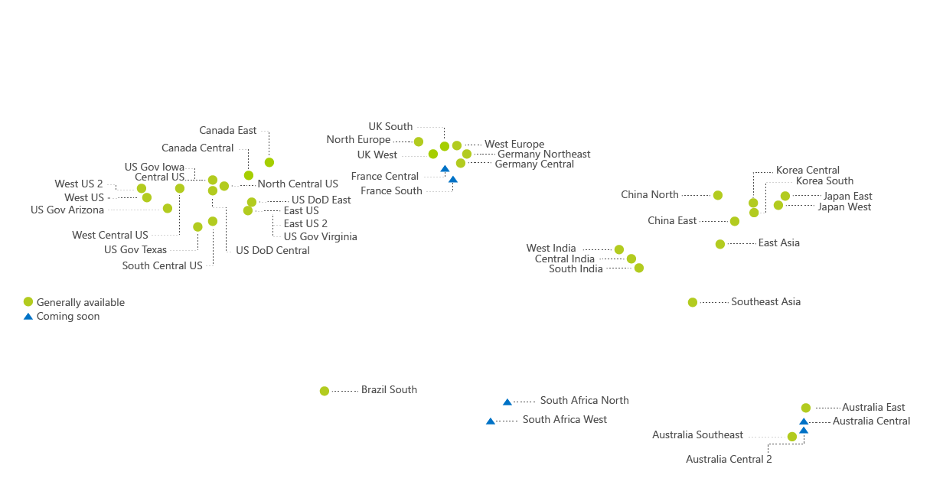
ADLS GEN2 Availability
Available in
ALL AZURE PUBLIC REGIONS

Slide 21

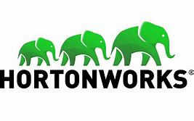



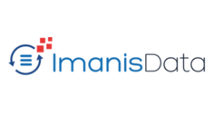










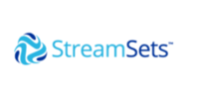
Rich partner network
Trusted ecosystem to accelerate time to value
DATA MIGRATION
SPARK & HADOOP ENGINES
BI + DATA PRESENTATION

Slide 22
ADLS GEN2 RESOURCES
Product page: https://azure.microsoft.com/en-us/services/storage/data-lake-storage/
Documentation page: https://docs.microsoft.com/en-us/azure/storage/blobs/data-lake-storage-introduction
Pricing page: https://azure.microsoft.com/en-us/pricing/details/storage/data-lake/

Slide 23
Q&A
Notes:
How do we migrate from Gen1 to Gen2?
On prem → they use ADF (Azure Data Factory) or 3rd party products
Why do I need Azure DW → only needed for pass through queries, better performance
Maximum capacity → as much data as you want, as many files as you want, max file size is 5 TB, Bandwidth is higher than blob
ADF using data bricks (check in the ADF documentation)
For data bricks they need to create a service principal (see documentation Tutorial: Access data lake store suing data bricks)
Storage Blob Data Contributor role (Access control- IAM) assigned to the service principal create
Be familiar with connecting your Data Bricks cluster with your ADLS Gen2 account. This requires a little script to be added to the notebook
Open Azure Storage Explorer and create a file system (a container)
Create a service principal and give access to ADLS Gen2
Add the snippet of code (tenant-id is AAD / Properties / Directory ID

